Slide 1
Location Based Services for Mobiles: Technologies and Standards
Shu Wang

Slide 2
Outline
Section I: Introduction
Historic overview
LBS concepts
LBS applications and market
Wireless Emergency System Mandates
LBS in cellular standards
Section II: Wireless Positioning Technologies
Basic positioning methods
Positioning Calculation
GPS and Galileo
Section III: Assisted GPS Architecture
Section IV: Implement Assisted GPS in Mobile Networks
LCS requirements
Location management in mobile networks
LCS architecture: control plane and user plane
LCS standards in mobile networks
Section V: Challenges for Mobile Location Services.
Regulations
Standardization
Market and Implementation

Slide 3


LBS: A Historic View
Emergency medical services (EMS)
In 1487, the first recorded use of ambulance was by the Spanish army, Queen Isabella of Spain.
Yellow pages (A more than $136B world wide market)
In 1886, Reuben H. Donnelly produced the first Yellow Pages.
In 1909, St. Louis produced the first Yellow Pages directory with coupons.
Local weather and traffic broadcast in radio and TV
Since 1960s, radio traffic report has been very popular in US.
On May 2, 1982, the weather channel (TWC) went on the air.
Emergency phone services
In 1968, AT&T and FCC come out with this nationwide emergency phone number – 911. (It is 1-1-2 across the European Union and 999 in UK).
In 2000, FCC issued a mandate of E911 to wireless carriers.
Notes:
When we are going to talk about LBS, many people think it is a generation-X term.
Some people may think it is so new or futuristic and usually exists in some Sci-Fi styled movies.
In fact, as you can see on this slide, we have been enjoying LBS for so many years, since more than 500 years ago.
In the fifteen century, Spanish army uses EMS, one of the typical LBS, for helping injured soldiers. And it actually worked very well.
Since 1880s, we have yellow pages, which turned out to be a huge success and have a $136B world-wide market. Now almost every household has at least one copy of it. And there are three copies delivered to my house very year.
Also in our daily work life, there is traffic radio and weather broadcast helping you being prepared.
When you have some emergency, you know what to do. Dial 9-1-1.
The amazing part of 9-1-1 and later E911 is, it not only provides you the emergent help, but also tries to deliver the help to you in the right place as soon as possible.
And this is possible only because it combines emergent service and LBS togather.

Slide 4
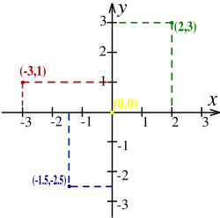
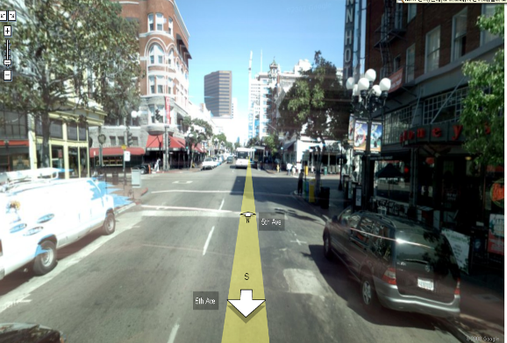
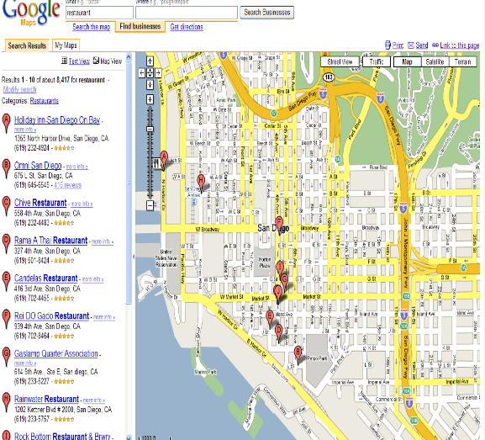
Basic Concepts of LBS
Position
“32° 49' 49.7964"-116° 49' 9.9228"”
Position appears to developers in the form of spatial coordinates.
It can be represented as a single point in the coordinate.
Location
“San Diego downtown gas lamp quarter”
Location is associated with a certain place in the real world.
If positioning delivers a spatial location, it will be mapped onto a descriptive location in order to be interpretable by the LBS user.
LoCation Service (LCS)
“Where am I?”
LCS should be distinguished from LBS as it exclusively deals with the localization of target, and also makes the resulting location data available to external actors.
It is responsible for the generation and delivery of location data.
Location Based Service (LBS)
“How can I go to the gas lamp quarter from here?”
LBS is the service that adds value to target locations provided by LCS. It uses knowledge of a mobile device’s location to offer value to the mobile subscriber or to a third party.
Notes:
We talk about LBS a lot recently, especially with the advance of mobile phone technologies. However, what exactly does LBS mean in our conversations?
In the LBS used by most people, there are four basic concepts in it.
Position is the concept, which is defined for machine or for computer to read and understand and handle.
For example, at latitude 32 degree north and longitude 116 degrees east
Location is the concept, which is for people to associate with a certain place in the real world.
The gas lamp quarter in San Diego downtown, which is correspond to the position, latitude 32 degree north and longitude 116 degrees east
Location Service, (LCS) is the process or service which help connect a position and a location.
Where am I?
LBS is the services which adds more value to the services provided by LCS.
How can I get to the gas lamp quarter from my current position?

Slide 5
LBS and A-GPS
LBS is gaining increasing popularity in mobile users. It should be included as a important feature of next generation mobile standards.
GPS-based positioning is known to be one of the most reliable positioning schemes with the best coverage and highest accuracy.
“With close to 1.18 billion mobile handsets sold in 2007 and an expected 1.8 billion in 2012, close to 30% of existing worldwide mobiles are GPS-capable in 2008. This number is increasing every year and predicted to more than 35% in 2012” -- Texas Instrument and gpsWorld.
“Global revenue from location-based services will hit $13.3 billion by 2013, compared with $515 million in 2007.” -- ABI Research

Slide 6
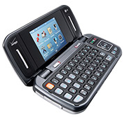
LBS Applications
Emergency Services
E-911
Roadside Assistance
Tracking
Commercial: workforce, fleet management
Family locator
Personal asset tracking
Navigation
Direction
Planning
Assistance
Billing
Road tolling
parking
LBS Alert
Promotion alert
advertising
Social Networking
Friend-finder
Instant messaging.
Network Operator Applications
Location sensitive billing
Cellular fraudulent detection and prevention
Wireless network optimization
Cellular inter-network border negotiation.
Service Provider Application
Fleet navigation and management
Wireless M2M
Remote access/management – mobile data/television
Auto insurance
Promotion and advertising
End-User Application
Tons of it.
Notes:
There are tons of available and imaginable LBS Applications. Here is a short list of them
There are many different ways to categorize these services and look at them in different perspectives. And this can help us understand LBS before start your own LBS project.
The left side is a traditional way to divide LBS applications. The right side is more from a LBS client perspective.
As we will mention this later, to understand LBS from a client perspective is one of the key factors to insure the success of LBS.

Slide 7
LBS Services in Market
Notes:
Here are three typical examples of LBS application in the market.
One of the reasons I put them together on this slide, I want to show you that when we design LBS, it is very important to ask ourselves several questions
Which customer segment it targets to?
Is it easy to use?
How does it add additional values to the clients, compared with other solutions if available?
Does it meet the privacy and security concerns of the customers or not?

Slide 8




















LBS Companies
Chipset
Providers
Software
Providers
System
Providers
Service
Providers
Notes:
We have so many LBS applications. This also means we have lots LBS companies.
Here is a short list. And I guess most of them you are already familiar with.
Here what I did is to make a segmentation on these companies and position them different in the LBS food chain.
I guess one thing I need mentioned is, some companies may work on more than one segment of LBS.
Then, if you want to start a LBS project, it will be easy for you to understand who is your competitor and who will be your partner.

Slide 9
Major Design Challenges
Positioning technologies
Different levels of accuracy required for various services
Multiple mobile positioning techniques with varying accuracy
Quality of position: horizontal accuracy, response time, etc.
Privacy
“Right to be let alone”
Users care about their privacy and are concerned with any intrusions.
Dilemma: LBS may be highly beneficial while it can do harm to the user’s privacy.
Interoperability
Key for LBS to expand from a niche service to a mass market service
Standards help LBS providers deliver products and services while reducing cost and business risks.
Emergency services
Timely delivery of accurate emergency call locations to the close emergency station
Demanding emergency service mandates in the US and the EU
Notes:
Now after you understand the LBS market and some success factors, before starting your LBS project, I think there will be another question in your mind. What kind of challenges I will face in my future LBS project.
Actually different LBS projects may have their own major challenges. Here we combined those major design challenges met by previous LBS designed for your considerations.

Slide 10
Key Factors to LBS Success
Compelling applications
Valuable to consumers or businesses
Easy and intuitive to use
Good return on the investment.
Handset availability
Wide range of LBS-capable handsets
Internet-friendly
IP-based user plane standards.
Good business model
Customer segmentation is important
Adopt applications from 3rd parties.
Help operators increase revenue.
User awareness and promotion
Security and privacy concerns
Notes:
Here is a list of several key factors we believe to be critical to the success of your LBS project. And some of them we mentioned in the previous slides.

Slide 11
The US Wireless Enhanced 911
The FCC Wireless Enhanced 911
Phase I: Within six months after a request by a PSAP, the carrier shall provide the telephone number and the cell site location for this 911 call.
Phase II: Within six months of a request by a PSAP, more precise location information, such as the latitude and longitude of the caller, shall be provided.
Network-based solutions, 100 meters for 67%; 300 meters for 95%.
Handset-assisted solutions, 50 meters for 67%; 150 meters for 95%.
By September 11, 2012, even more precise location information shall be provided. It requires wireless operators to average their compliance over each local region instead.
The DOT NG 911 Initiative
The NG 911 Initiative is a R&D project to help establish a digital, IP-based foundation for the delivery of multimedia 911 "calls.“
The NG 911 initiative will establish the foundation for public emergency communications services in a wireless mobile society.
Notes:
When we talk about LBS, we really need talk about FCC E911 and standardization issues. In the following two slides we are going to address them individually.
For Phase I,
tile April 1998. In it, the carriers shall must cell site, sector and call-back number for 911 calls.
For Phase II,
tile 2002, the carriers must ensure that at least 95% of all new digital handsets activated are ALI-capable.
Within 2 years or by Dec. 31st, 2004, whichever is later, from a PSAP request is received and undertake reasonable efforts to achieve 100% penetration of ALI-capable handsets in its total subscriber base.

Slide 12



LBS Standardization
3GPP and 3GPP2 (3rd Generation Partnership Project)
Telecommunication industry collaborations to make 3G mobile phone system specifications within the scope of ITU.
Interest in positioning technologies in cellular networks and related location services.
OMA (Open Mobile Alliance)
A standards organization for delivering open technical specifications for application level and service frameworks.
Provide protocols and interfaces that enable the exchange of location data between different networks.
IETF (Internet Engineering Task Force)
An open standards organization develops and promotes Internet standards.
Specify protocols for integrating location data with Internet or Web-based applications.

Slide 13
Acronyms
3G – The Third Generation
3GPP – The 3rd Generation Partnership Project
3GPP2 – The 3rd Generation Partnership Project 2
ALI – Automatic Location Identification
CDMA – Code Division Multiple Access
CGALIES - the Coordination Group on Access to Location Information for Emergency Services
EMS – Emergency Medical Services
EMTEL – Emergency Telecommunications
ETSI – The European Telecommunications Standards Institute
GSMA – The GSM Association
GPS – Global Positioning System
IETF – Internet Engineering Task Force
LBS – Location Based Services
LCS – Location Services
LORAN – Long Range Navigation
NGN – Next-Generation Network
OCG – Operational Co-ordination Group
OMA – Open Mobile Alliance
PSAP – Position Service Access Point
TWC – The Weather Channel
UMTS – Universal Mobile Telecommunications System
UTRAN -- UMTS Terrestrial Radio Access Network

Slide 14
Section II: Wireless Positioning Technologies
Basic Positioning Methods
Dead reckoning
Proximity sensing: signal signature tracking
Trilateration: signal strength analysis and TOA
Multilateration: TDOA
Triangulation: AOA
GPS and Galileo
Global Positioning System
Galileo

Slide 15
Dead Reckoning
Dead reckoning is the processing of estimating one’s current position based upon
previously determined positions
known speed and acceleration
moving direction
elapsed time
traveled distance
courses.
It is well known to be the method used by Christopher Columbus for discovering the New World and modern inertial navigation systems, for example, for marine navigation and air navigation.

Slide 16
Proximity Sensing: Signal Signature
In the proximity sensing, the mobile position is derived from the base-station coordinates. It is usually determined by tracking signal signatures or cell identity (Cell ID) of neighboring base stations.
Every base station has its own signal pattern, which is usually embedded into its pilot and some synchronization channels.
Signal signature based technologies usually comprise
signal signature estimation
neighbor list update
mobile location analysis
Traffic Pattern Theory.
A person’s daily activity pattern is pretty regular, which comprises several major events, such as school, work, home and shopping.

Slide 17
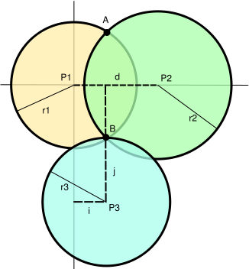
Trilateration
Trilateration: it determines the relative positions of objects using
the known locations of two or more reference points, e.g. base stations.
the measured distance between the mobile and each reference point.
Trilateration with signal strength analysis:
the distance is proportional to its received signal strength,
SS_{rx} = P_{tx} - 10αlog(d) + X (dB) .
Trilateration with time of arrival (TOA): the distance can be obtained by estimating TOA of received signals.

Slide 18
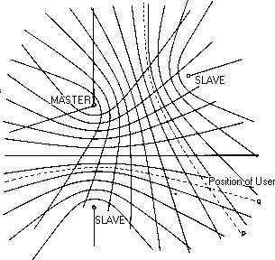
Multilateration: TDOA
Multilateration, also known as hyperbolic lateration, usually is the positioning process by estimating time difference of arrival (TDOA) of a signal.
TDOA method is similar to TOA estimation but doesn’t need a clock synchronization.

Slide 19
Triangulation: AOA
Triangulation is the process of positioning a mobile with measuring
Angles of arrival (AOA) between the mobile and reference points, and
sides of the mobile and reference points.
Triangulation is used for many purposes, including survey, navigation, astrometry, etc.
The AOA is usually determined by using multiple antennas at a base station
The fundamentals are well established in the context of array signal processing.
Many schemes are developed for estimating AOA, such as
Maximum output power,
Maximum likelihood estimation,
Subspace-based approaches.

Slide 20
Cartesian and Spherical Coordination System

Slide 21
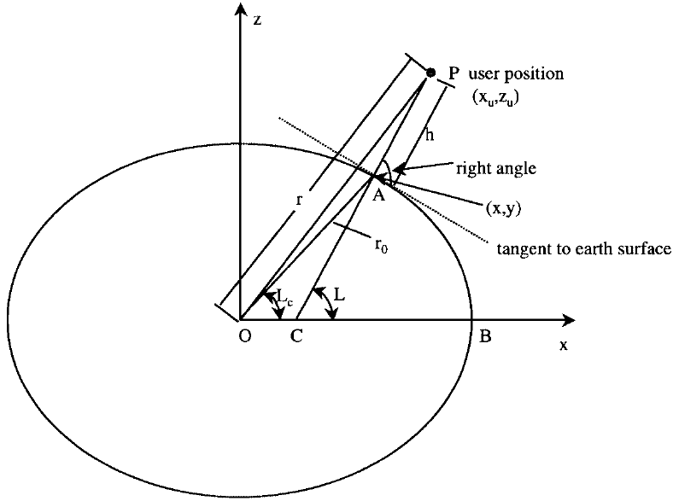
Earth Geometry
The earth is not a perfect sphere but is an ellipsoid, for which there are two latitudes
Geocentric latitude Lc
Geodetic latitude L.

Slide 22
Position Calculation

Slide 23
Dilution of Precision and Satellite Selection

Slide 24
GPS: Overview
GPS is a Global Navigation Satellite System for determining the positions of receivers using signals broadcast by satellites.
The first experimental Block-I GPS satellite was launched in 1978.
It was developed and operated by US government to enhance the effectiveness of allied and US military forces.
As of September 2007, there are 31 actively broadcasting satellites in the GPS constellation.
Satellites orbit 20,163 kilometers above the earth at 3.87 km/s
6 orbital planes, each with 4+ satellites. Typically 6 to 12 satellites are visible from any place on the earth.
Since 1983, GPS has become an aid to civilian navigation worldwide, and a useful tool for survey, commerce, and scientific uses.

Slide 25
GPS: System Structure

Slide 26
GPS: Satellite Signal Characteristics
All GPS satellites transmit on L1 (1575.42 MHz) and L2 (1227.6 MHz) frequencies. Each satellite uses different ranging codes:
C/A code (coarse/acquisition code): 1ms period and 1.023MHz chip rate.
P-code (private or precision code).
The C/A code is modulated onto the L1 carrier only, while the P-code is modulated onto both the L1 and L2 carriers.
The C/A code is less precise and less complex than the P-code and available to all users.
The P-code is intended for military uses and is added to both L1 and L2.

Slide 27
GPS L1 Signal Spectra

Slide 28
Generation of C/A Code

Slide 29
GPS: Signal Waveform

Slide 30
GPS: Message Format

Slide 31
GPS: Navigation Data
TLM – Telemetry: 30 bits, sent at the beginning of each frame.
It is used for data synchronization and satellite maintenance.
They are usually constant for any one satellite for a long period of time.
HOW – Handover Word: 30 bits, sent after TLM.
It indicates the time at the beginning of the next subframe.
It also contains a sub-frame ID, some flags and parity bits.
Ephemeris: It is sent in each frame by each satellite.
It may take the GPS receiver up to 30 seconds to acquire Ephemeris.
Almanac: It is spread out over all 25 frames of the message.
For receiving the complete Almanac, the GPS receiver may need about 12.5 minutes.

Slide 32
Satellite Data in Subframe 1(1/2)
Week number (61–70): These 10 bits represent the MSB of the Z counts and indicate the number of weeks from midnight on the night of January 5, 1980. Users must count the rollover if it is over 1,023 weeks.
User range accuracy (73–76): These 4 bits give the predicted user range accuracy and its value N ranges from 0–15. The accuracy value X is:
If N is 6 or less, X=2^{(1 +N/2)} (rounded-of-values N=1, X=2.8; N=3, X=5.7; N=5, X=11.3).
If N is 6 or more, but less than 15, X=2^{(N − 2)}.
N=15 will indicate the absence of an accuracy prediction and will advise the user to use that satellite at the user’s risk.
Satellite health (77-82): These 6 bits represent the health indication of the transmitting satellite. The MSB indicates a summary of the health of the navigation data, where
0 All navigation data are OK.
1 Some or all navigation data are bad.
Additional satellite health data are given in subframes 4 and 5. The data given in subframe 1 may differ from that shown in subframes 4 and/ or 5 of other satellites, since the latter may be updated at a different time.

Slide 33
Satellite Data in Subframe 1 (2/2)
Issue of data, clock (IODC) (83–84 MSB, 211–218 LSB): These 10-bit data indicate the issue number of the data set and thereby provide the user with a convenient means of detecting any change in the correction parameters. The transmitted IODC will be different from any value transmitted by the satellite during the preceding seven days.
Estimated group delay differential T_{GD} (197–204): This 8-bit information is a clock correction term to account for the effect of satellite group delay differential.
Satellite clock correction parameters: This subframe also contains the four additional satellite clock correction parameters:
t_{oc} (219–234),
a_{f 0} (271–292),
a_{f 1} (249–264),
and a_{f 2} (241–248).
In subframe 1 there are some reserved data fields and their locations are 71–72; 91–114; 121–144; 151–174; 181–196. All reserved data fields support valid parity within their respective words.

Slide 34
Ephemeris Parameters in Subframe 2

Slide 35
Ephemeris Parameters in Subframe 3

Slide 36
Almanac Data in Subframe 4/5
Almanac data: The almanac parameters provided in subframes 4 and 5 The almanac data are much less accurate than the detailed ephemeris data of subframes 2 and 3. However, the almanac data are valid for longer periods of time and do not require frequency updates.
Eccentricity: This shows the amount of the orbit deviation from circular (orbit). It is the distance between the foci divided by the length of the semi-major axis (our orbits are very circular).
Time of Applicability: The number of seconds in the orbit when the almanac was generated. Kind of a time tag.
Rate of Right Ascension: Rate of change in the measurement of the angle of right ascension as defined in the Right Ascension mnemonic.
Square Root of Semi-Major Axis: This is defined as the measurement from the center of the orbit to either the point of apogee or the point of perigee.
Right Ascension at Time of Almanac (TOA): Geographic Longitude of the Ascending Node of the Orbit Plane at the Weekly Epoch.
Argument of Perigee: An angular measurement along the orbital path measured from the ascending node to the point of perigee, measured in the direction of the SV's motion.
Mean Anomaly: Angle (arc) traveled past the longitude of ascending node (value= 0-180 degrees or 0-negative 180 degrees). If the value exceeds 180 degrees, subtract 360 degrees to find the mean anomaly. When the SV has passed perigee and heading towards apogee, the mean anomaly is positive. After the point of apogee, the mean anomaly value will be negative to the point of perigee.
Af(0): SV clock bias in seconds
Af(1): SV clock Drift in seconds per seconds

Slide 37
GPS: Positioning Principle

Slide 38
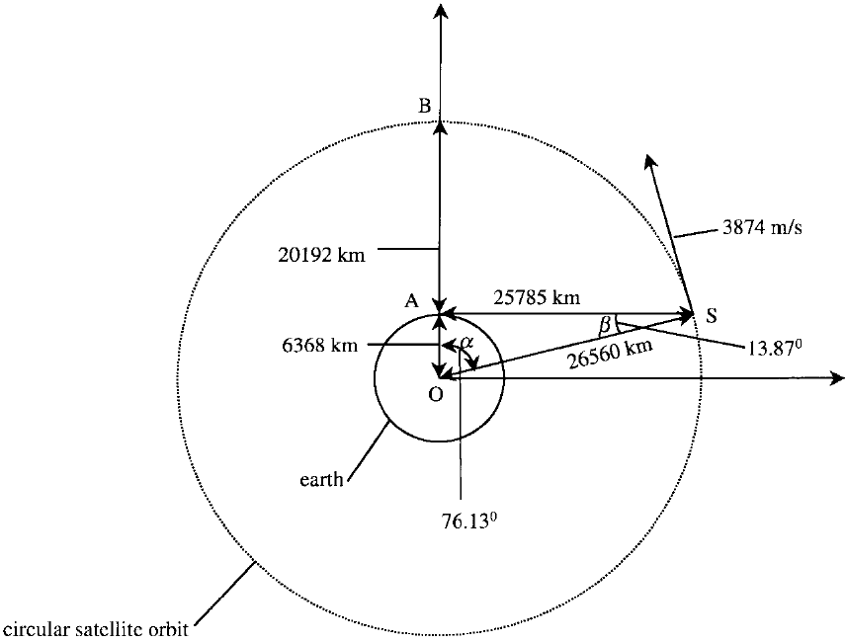
Satellite Signal Strength Characteristics
Maximum Power Differential: Suppose the receiver has an omini-directional antenna pattern. Since the power level is inversely proportional to the distance square, the difference in power level can be found as 2.1 dB
Local Signal Strength: The signal strength can be obtained from
the power of the transmitting antenna, 26.8 dBw.
the beam width of the antenna, 21.3º
the distance from the satellite to the user, 20192 - 25785km
and the effective area of the receiving antenna.

Slide 39
Doppler Effects
Two approaches are used to find the Doppler frequency rate:
A simple way is to estimate the average rate of change of the Doppler frequency.
The other one is to find the maximum rate of change of the Doppler frequency.
The average rate of change of the Doppler frequency: 0.54 Hz/second.
The maximum rate of change of the Doppler frequency: 0.936 Hz/second.
Doppler effects due to user acceleration:
Every 1 g acceleration results in 51.5 Hz/second Doppler frequency change rate.

Slide 40
True and Mean Anomaly

Slide 41
GPS Receiver Functions
Measure approximate distance to 3 or more satellites.
The receiver measures the time required for signal to get from the satellite to the receiver.
Calculate the distance.
Obtain satellite positions from satellite broadcasts.
Almanac: approximate positions used to set approximate satellite search ranges, etc.
Ephemeris: precise position used in trilateration calculations.
Calculate the position using trilateration.
Correct for errors to improve accuracy.
Calibrate the clock bias.
(Optional) Apply differential correction.
Correct deliberate noise, such as selective availability.
Calibrate variable ionospheric and tropospheric propagation delays.

Slide 42
GPS Receiver Design Considerations
Antenna: A GPS antenna should cover a wide spatial angle to receive the maximum number of signals.
It can provide a good trade-off between the maximum number of receiving satellites and interference.
It should have uniform gain over a very wide spatial angle.
It should help reject or minimize multipath effects.
It has a small size for mobile devices.
Amplification and Band Pass Filter
Sampling and Digitalization
Direct Digitalization

Slide 43
Considerations in GPS Signal Acquisition
A typical acquisition data length is 10 bits, which is about 10ms
The C/A code is 1ms period and 1.023MHz chip rate.
The navigation data is 20ms or 20 C/A code long.
Doppler effect on the C/A code acquisition.
The maximum Doppler shift is 6.4Hz on 1.023Hz C/A code.
It take a about 78ms to change
Frequency Search Step Size
The Doppler frequency range is -10KHz ~ +10KHz.
The frequency search step size roughly is the inverse of the data length.
1 ms data length has FFT resolution of 1 KHz
10 ms data length has FFT resolution of 100Hz

Slide 44
GPS Signal Acquisition

Slide 45
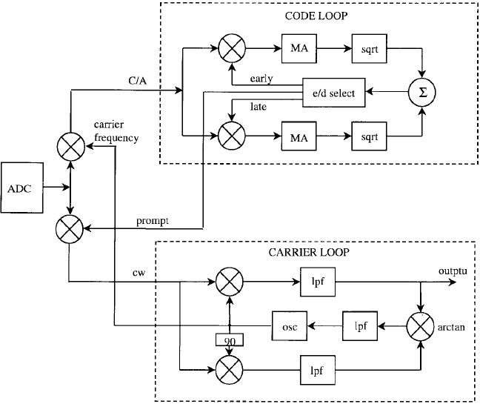
GPS Signal Tracking
To track a GPS signal two tracking loops are required.
One loop is used to track the carrier frequency and is referred to as the carrier loop.
The other one is used to track the C/ A code and is referred to as the code loop.
The basic steps include
Set the bandwidths and the gain of the code and carrier loops. The loop gain includes the gains of the phase detector and the VCO. The bandwidth of the code loop is narrower than the carrier loop because it tracks the signal for a longer period of time. Choose the noise bandwidth of the code loop to be 1 Hz and the carrier loop to be 20 Hz. This is one set of several possible selections that the tracking program can operate or function.
Select the damping factor in Equation (8.25) to be c .707. This z value is often considered close to optimum.
The natural frequency can be found from Equation (8.26).
Choose the code loop gain (k0k1) to be 50 and the carrier loop gain to be 4p × 100. These values are also one set of several possible selections. The constants C1 and C2 of the filter can be found from Equation (8.39).

Slide 46
Relative Pseudorange
Because the clock bias of the receiver is an unknown variable, the pseudorange can be measured only in a relative way. For example, the beginning point of subframe 1 is used as the reference point.
All the beginning points of subframe 1 from different satellites are transmitted at the same time except for the clock correction terms of each satellite.
Since the beginnings of subframe 1 from different satellites are received at different times, this difference time represents the time (or distance) difference from the satellite to the receiver. Therefore, it represents the relative pseudorange.
It takes two steps to find the beginning of subframe 1 in terms of the actual digitized input data points.
The first step is to find the index of the beginning of the C/ A code just before subframe 1.
The second step is to find the time between the desired beginning of the C/ A code to the beginning of subframe 1.

Slide 47
Calculating Satellite Positions

Slide 48
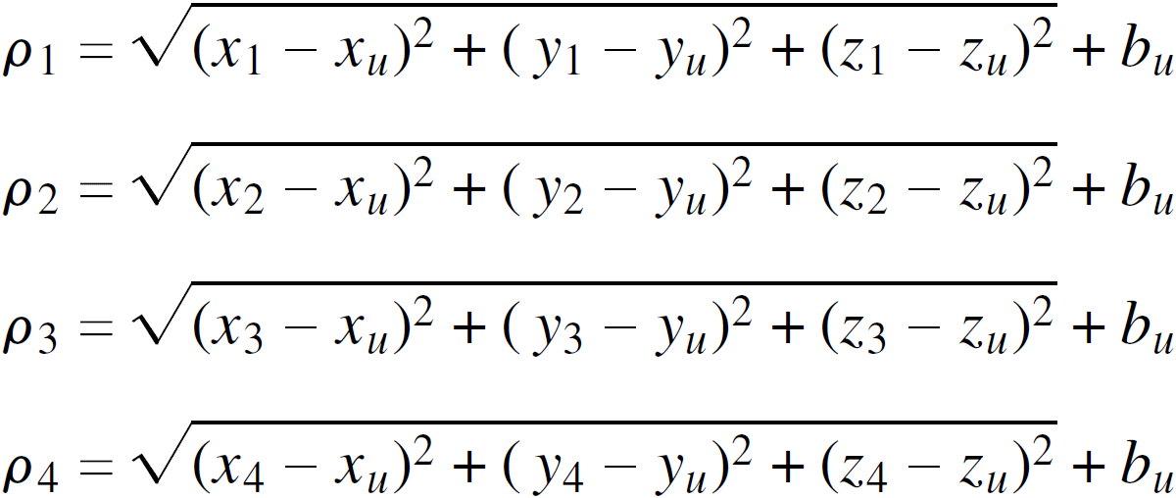
Calculating User Positions

Slide 49
GPS Positioning Error Sources

Slide 50
GPS Positioning Error Sources (2/2)
Error sources in the space segment
ephemeris (orbital) error: it usually is in the order of 2-5m.
satellite clock errors: it usually is in the order of 2.3m with ephemeris effect
selective availability (03/1990 – 05/2000): delta error & epsilon error.
dilution of precision: Maximum allowable error = GPS receiver accuracy • DOP
Propagation delays
multipath error: it affects both the carrier-phase and pseudorange measurement.
ionospheric delay: it mostly is of the order of 5-15m.
tropospheric delay: it is about 2.3m at Zenith and 20-28m for a 5º elevation angle.
Error sources in the user segment
system noise: a typical error value of this is of the order of 0.6m.
antenna distortion: It is typically in the order of a few centimeters.

Slide 51
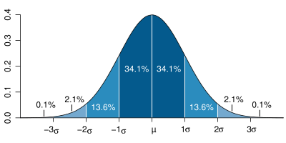
GPS Error Budget for E911
 | Absolute |  | Differential
Error Source | P Code | L1 C/A Code | P Code | C/A Code
Sat. Clock & Ephemeris Errors | 3.9 | 3.9 | 0 | 0
Ionospheric delay | 3.1 | 9 | 0 | 0
Tropospheric Delay | 2.0 | 2.0 | 0.15 | 0.15
Receiver Noise and Resolution | 1.1 | 11.1 | 1.1 | 11.1
Multipath | 1.2 | 12 | 1.2 | 12
Other |  |  | 0 | 0
*Selective Availability |  | 30 | 0 | 0
Total System Error 1σ | 5.6 | 35.6 | 1.3 | 16
Position Error (m) PDOP = 2.92 | 16.3 | 104 | 3.8 | 48
DOP | Rating | Description
1 | ideal | applications demanding the highest possible precision.
2-3 | Excell. | Meet all but the most sensitive applications.
4-6 | Good | the minimum appropriate for making business decisions.
7-8 | Mod. | Can be used for calculations. A more open view of the sky is recommended.
“Differential operation of Navstar GPS”, R. M. Kalafus, Vilcans, N. Knable, Navigation Vol. 30, No. 3, 1983

Slide 52
Assisted GPS: Overview
A-GPS with assistance server were developed to enhance the positioning performance of a GPS receiver and satisfy FCC’s E911 mandate.
It was firstly come out by Bell Labs before the 1996 FCC ruling.
Assistance server can increase the capability of a stand-alone receiver.
It can roughly locate mobiles along by itself.
It can supply more GPS orbital data to the mobile.
It has better knowledge of atmosphere conditions and other errors as well as better augmentation capability.
A-GPS help improve positioning in terms of
Location accuracy: the positioning error.
Yield: the positioning success rate.
Time to fix: the time for positioning.
Battery consumption: power consumption for positioning.
Mobile device cost.

Slide 53
Assisted GPS: GPS vs. A-GPS

Slide 54
Assisted GPS: Assisting Information
Precise GPS satellite orbit and clock information
Reference time
Reference location
Initial position and time estimate
Almanac
Acquisition assistance
Real-time integrity.
Universal Time Co-ordinates
Satellite selection and range information
Differential GPS (DGPS) corrections
Navigation model (contains satellite ephemeris and clock corrections)
Ionospheric model
UTC model

Slide 55
Assisted GPS: The Performance
Notes:
Add some pattern.

Slide 56
Galileo : Overview
Galileo is a Global Navigation Satellite System by the European Union.
It is a joint initiative of the European Space Agency and the European Commission.
The goal is to provide an accurate, guaranteed global positioning service under civil control.
With Galileo, the European Union wants
to control the geopositioning system and guarantee the access.
to develop more civilian applications including new paid services and have it under civil control.
The current status of Galileo project
Participants: the 27-state European Union, the 15-state European Space Agency and some non-EU country partners.
Budget: €5.4 billion.
Schedule: constellation deployment around 2011; full operation around 2013.

Slide 57
Galileo System
Technically, Galileo is similar to GPS
Satellites transmit signals with PN codes for ranging.
Additional data like the Almanac and Ephemeris in GPS are provided to support the position determination.
Similar number of satellites and orbits are planed.
Galileo receivers are expected to also have the basic pseudoranging, calibration, trilateration and clock bias compensation components as GPS receivers.
Parameters | Galileo | GPS
Space Vehicles | 30, including 3 spares | 31
Constellation | Walker 27/3/1 | Walker 24/6/1
Planes | 3 | 6
Altitude | 23,616 km | 20,163 km
Inclination | 56 degree | 55 degree

Slide 58
Galileo Services
Open services of higher accuracy.
Free service for mass market.
Meter-level accuracy.
New paid commercial services.
Encrypted.
Guaranteed services for a fee.
Claimed centimeter-level accuracy
Enhanced governmental services
Encrypted.
Continuous availability even in times of crisis.
Safety of life services
Open service but encrypted.
For applications such as automated aircraft landing
Two-way search and rescue services.
Feasible to send feedback.

